Slide 1
Biology
Sylvia S. Mader
Michael Windelspecht
Chapter 21
Protist Evolution and Diversity
Copyright 2022 © McGraw Hill LLC. All rights reserved. No reproduction or distribution without the prior written consent of McGraw Hill LLC.

Slide 2
Outline
21.1 General Biology of Protists
21.2 Supergroup Excavata
21.3 Supergroup Chromalveolata
21.4 Supergroup Rhizaria
21.5 Supergroup Archaeplastida
21.6 Supergroup Amoebozoa
21.7 Supergroup Opisthokonta

Slide 3
21.1 General Biology of Protists
Classified in the domain Eukarya and the kingdom Protista
  Endosymbiotic hypothesis
    Aerobic bacteria became mitochondria.
    Cyanobacteria became chloroplasts.
  Vary in size from microscopic algae and protozoans to kelp more than 200 m in length
  Although many protists are unicellular, they are highly complex
    Some protists are colonial or filamentous.

Slide 4
Nutrition of Protists
  Algae are photosynthetic
  Protozoans are heterotrophic
    Some ingest food by endocytosis
  Some protozoans are mixotrophic
    Mixotrophs combine autotrophic and heterotrophic nutritional modes

Slide 5
Life Cycle of Protists
  Asexual reproduction is most common
  Sexual reproduction may occur when environmental conditions are unfavorable
    Formation of dormant cells known as spores and cysts allow protists to survive hostile environments
      In parasites, a cyst may serve as a means of transfer to a new host

Slide 6
Biology of Protists
Protists are of enormous ecological importance
Photoautotrophs:
  Produce oxygen
  Form the foundation of the food chain in both freshwater and saltwater ecosystems
  Are a major component of plankton
    Organisms that are suspended in the water
    Serve as food for heterotrophic protists and animals
    Whales, the largest organism in the sea, feed on plankton, some of the smallest organisms in the sea

Slide 7
Evolution and Diversity of Protists
  Complexity and diversity of protists makes them difficult to classify
    Protists are not monophyletic
      They do not all belong to the same evolutionary lineage
    Classified into six supergroups
      Supergroup is a taxonomic group below domain and above kingdom

Slide 8
Supergroups
Table 21.1 Eukaryotic Supergroups
Supergroup | Members
Excavata | Diplomonads, parabasalids, euglenozoans
Chromalveolata | Dinoflagellates, apicomplexans, ciliates, diatoms, golden brown algae, brown algae, water molds
Rhizaria | Cercozoans, foraminiferans, radiolarians
Archaeplastida | Red algae, green algae, land plants
Amoebozoa | Amoeboids, slime molds
Opisthokonta | Fungi, choanoflagellates, animals
Table divided into two columns summarizes eukaryotic supergroups. The column headers are marked from left to right as: Supergroup and members.

Slide 9
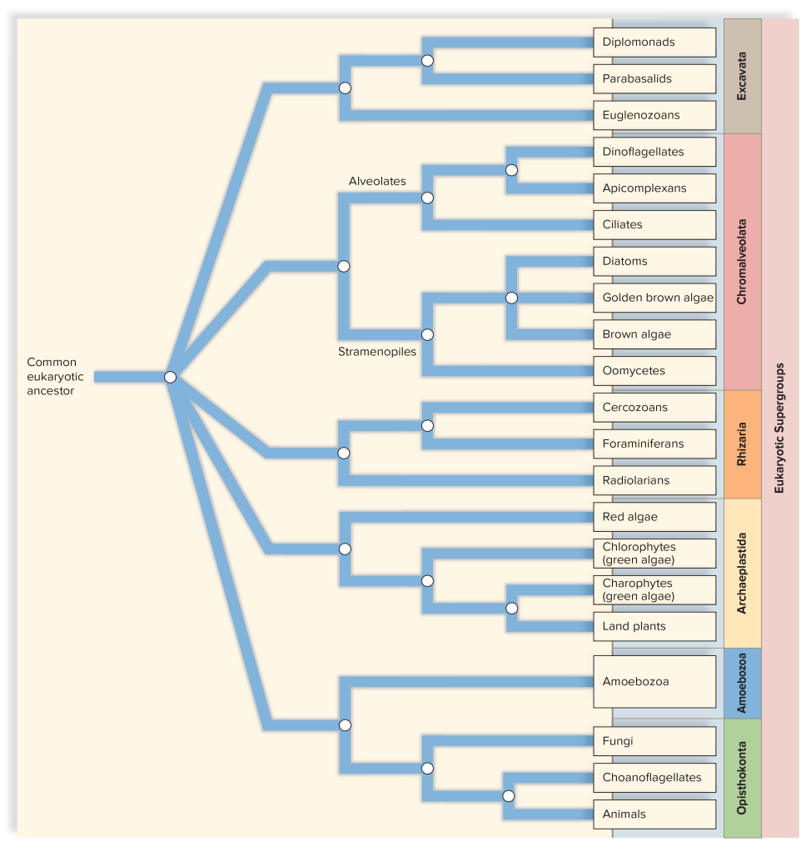
Proposed Evolutionary Relationships Among the Eukaryotic Supergroups
Figure 21.1
Access the text alternative for slide images.

Slide 10
21.2 Supergroup Excavata
Excavates:
Atypical or absent mitochondria
Distinctive flagella and/or deep (excavated) oral grooves
Excavates include:
  Diplomonads
  Parabasalids
  Euglenozoans

Slide 11
Diplomonads and Parabasalids
  Unicellular and flagellated
  Endosymbionts of animals
  Survive in anaerobic (low-oxygen) environments
  Lack mitochondria
  Rely on fermentation for ATP production
  Two nuclei and two sets of flagella

Slide 12
Parabasalids and Diplomonads
Diplomonads
  Cell has two nuclei and two sets of flagella
  Well known for causing various diseases in humans
    Giardia lamblia causes severe diarrhea
    Cysts are transmitted in contaminated water
    Beavers are important reservoir hosts
Parabasalids
  Unique fibrous connection between the Golgi apparatus and flagella
  Trichomonas vaginalis causes trichomoniasis, a sexually transmitted disease that only causes symptoms in females

Slide 13
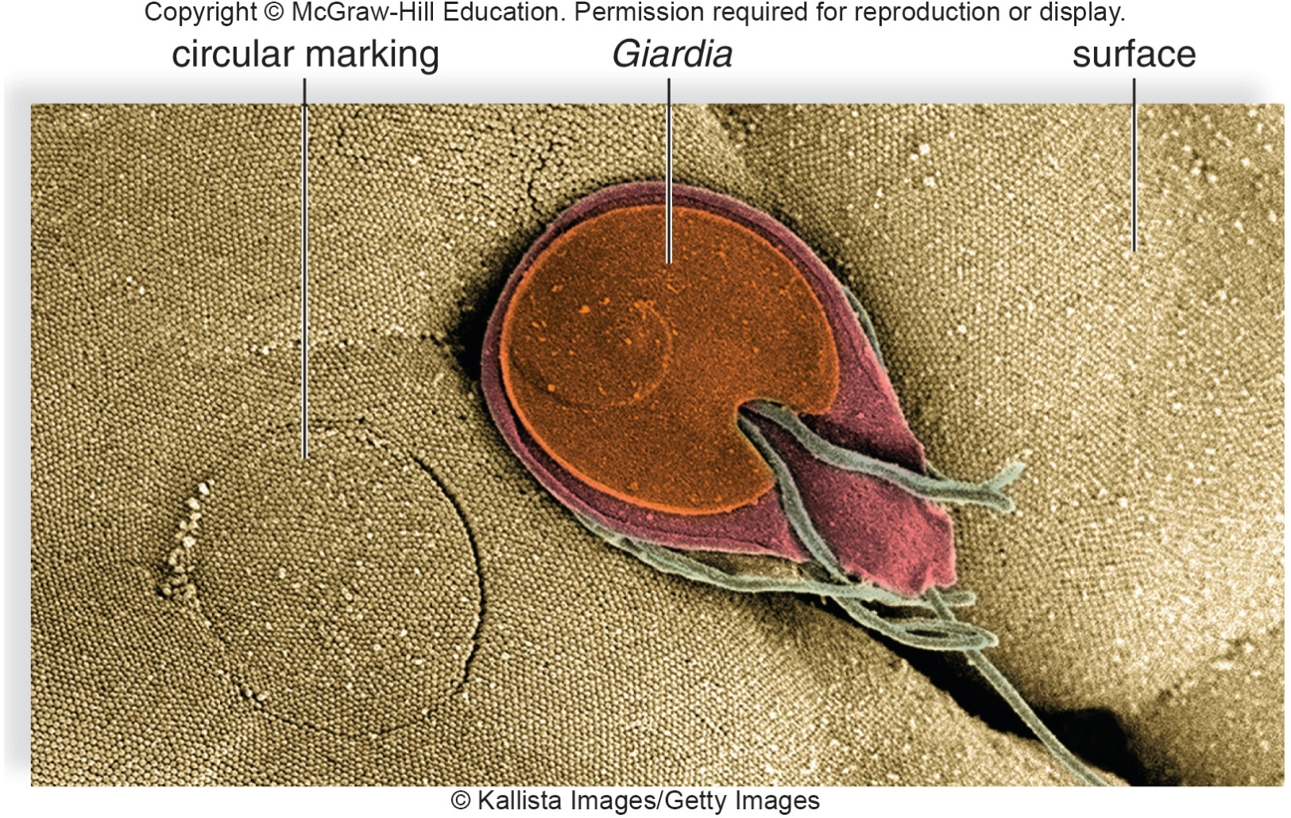
Giardia lamblia
Figure 21.2
Kallista Images/Getty Images

Slide 14
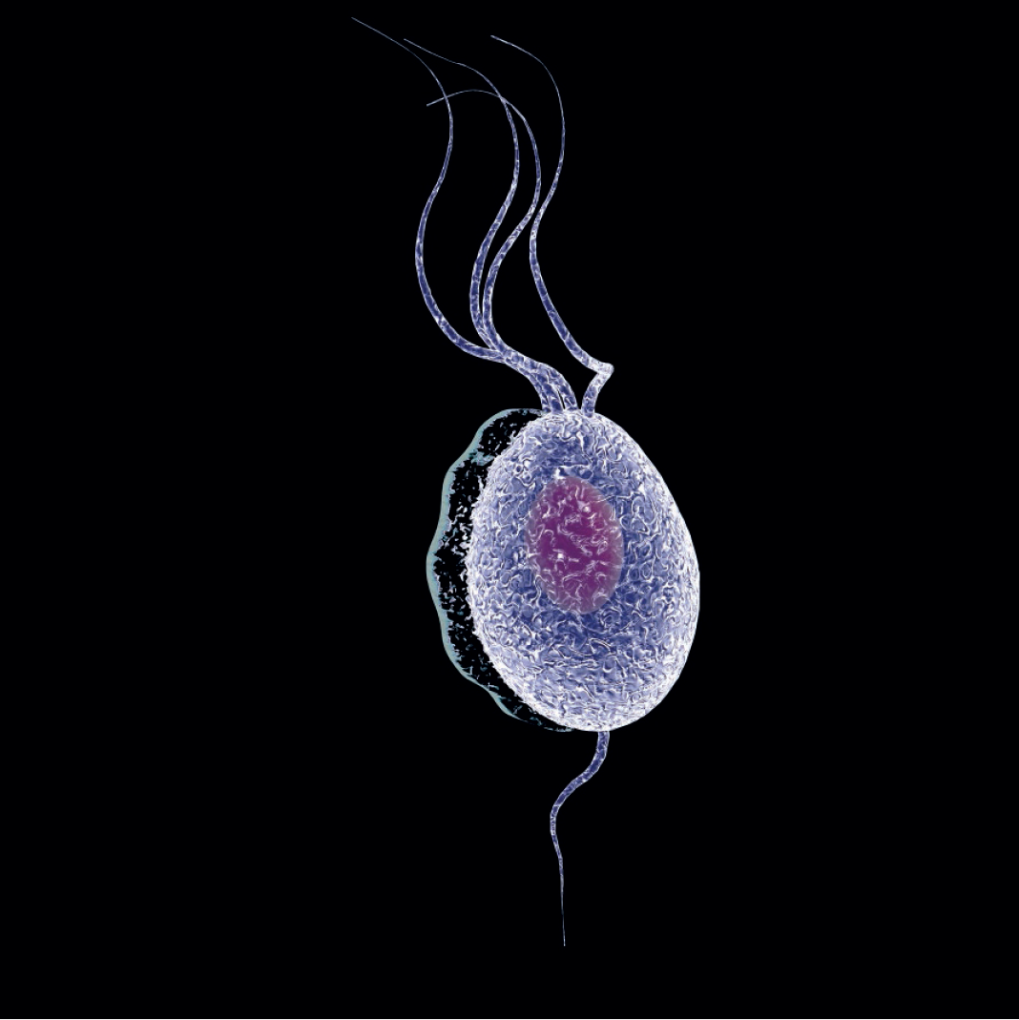
Trichomonas vaginalis
Figure 21.3

Slide 15
Euglenozoans
  Small freshwater unicellular organisms
  Possess mitochondria
  Lack a cell wall and instead have proteins encircling the cell
  Includes:
    Free-living euglenids
    Parasitic kinetoplastids

Slide 16
Euglenids
  Asexual, single-celled freshwater protists
  Some are mixotrophs, some are photoautotrophs, some are heterotrophs
  Have two flagella and an eyespot that detects light
    One flagellum is much longer than the other
    Longer flagella is called a tinsel flagellum because of hairlike projections
  Cell is bounded by flexible pellicle
  Contractile vacuole rids body of excess water
  Chloroplasts, if present:
    Surrounded by three, rather than two, membranes
    Special region of the chloroplast, the pyrenoid, produces an unusual type of carbohydrate called paramylon

Slide 17
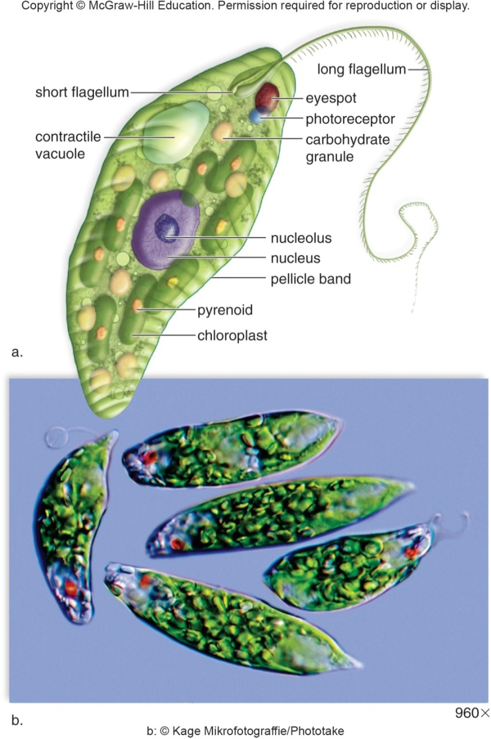
Euglena
Figure 21.4
Access the text alternative for slide images.
(b): Mikrofotograffie/Diomedia

Slide 18
Kinetoplastids
  Unicellular, flagellated protozoans
  Named for distinctive kinetoplast (large mass of DNA located in mitochondria)
  Trypanosomes are parasitic kinetoplastids
    Trypanosoma brucei causes African sleeping sickness
      Transmitted by the tsetse fly
      Causes lethargy due to inadequate supply of oxygen to the brain
    Trypanosoma cruzi causes Chagas disease

Slide 19
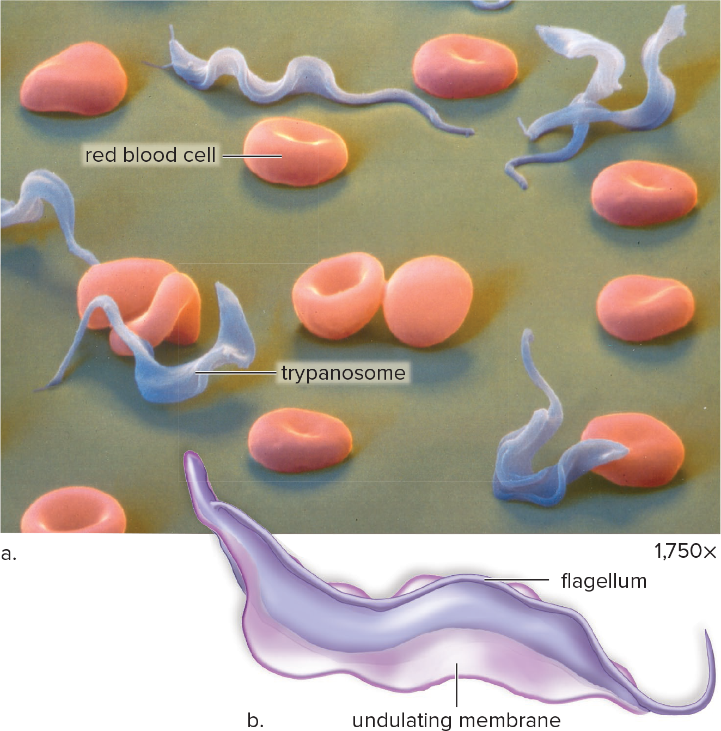
Trypanosoma brucei
Figure 21.5
(a): Eye of Science/Science Source

Slide 20
21.3 Supergroup Chromalveolata
Chromalveolata includes two large subgroups:
  Alveolates and Stramenopiles
    Alveolates:
      Single-celled
      Have small air sacs (alveoli) beneath plasma membrane
      May support cell surface or aid in membrane transport
    Includes:
      Dinoflagellates
      Apicomplexans
      Ciliates

Slide 21
Stramenopiles
    Includes:
      Diatoms
      Golden brown algae
      Brown algae
      Oomycetes

Slide 22
Dinoflagellates
  More than 2,000 species of dinoflagellates
  Morphology:
    Single cell is usually bounded by protective cellulose plates impregnated with silicates
    Typically have two flagella
      One flagella acts as a rudder
      The other causes the cell to spin as it moves forward

Slide 23
Dinoflagellate Features
  Endosymbiotic dinoflagellates called zooxanthellae are found in corals
    Dinoflagellates provide their host with organic nutrients
    Corals provide shelter, nutrients, and protection
  Alexandrium catanella can cause red tide
    Produce a powerful neurotoxin that causes massive fish kills
    Consuming shellfish during outbreak can cause respiratory paralysis in humans

Slide 24
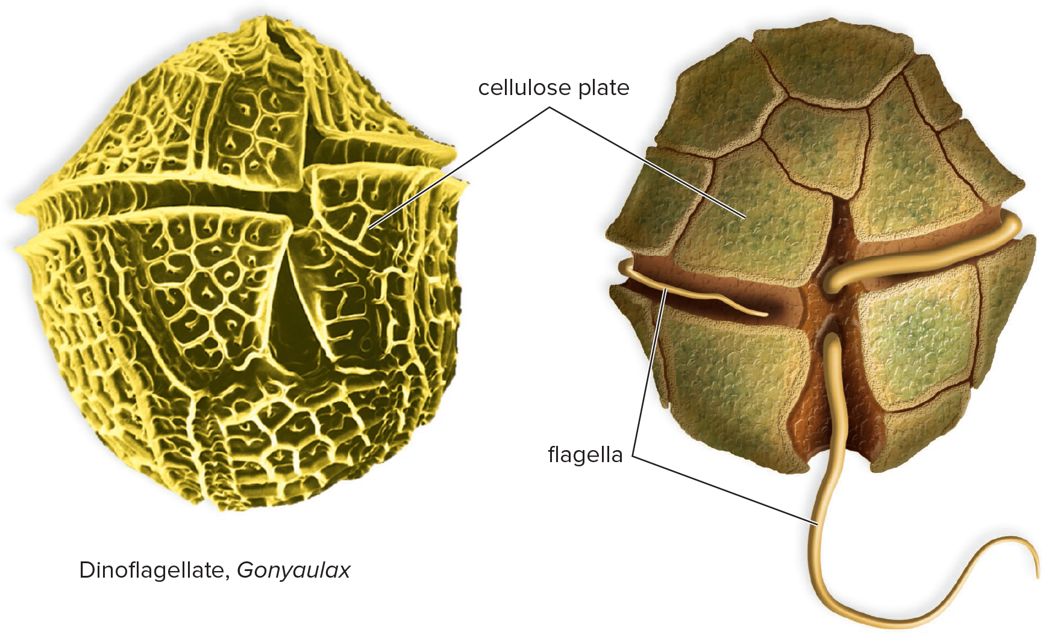
A Typical Dinoflagellate
Figure 21.6

Slide 25
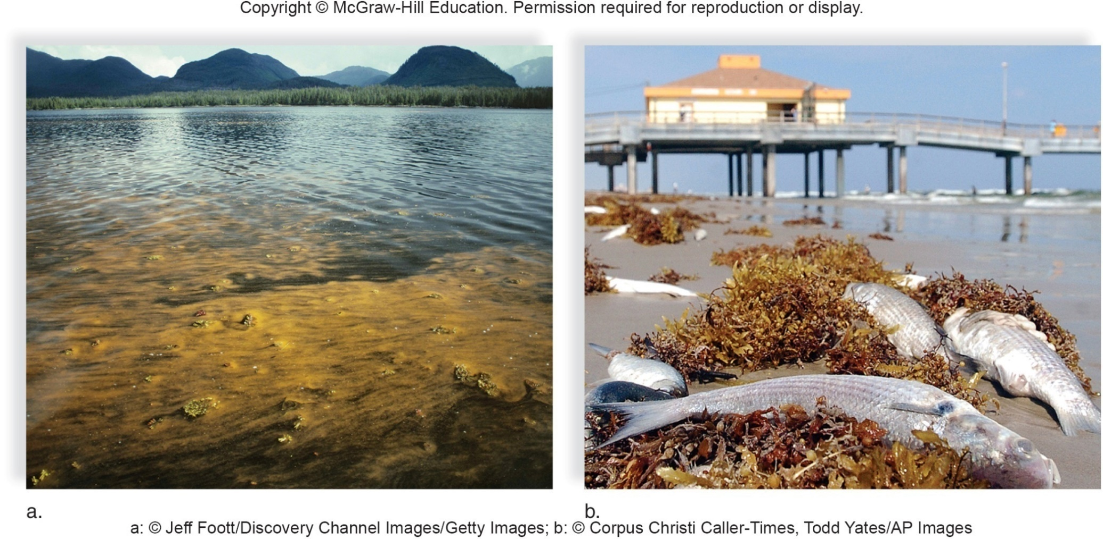
Dinoflagellate Bloom and Fish Kill
Figure 21.7
(a): Jeff Foott/Discovery Channel Images/Getty Images; (b): Corpus Christi Caller-Times, Todd Yates/AP Images

Slide 26
Apicomplexans
  Also known as sporozoans
  Non-motile, spore-forming, parasites of animals
  Unique organelle called apicoplast
    Used to penetrate host cell
  Most serious parasitic disease of humans is malaria
    Plasmodium spp
      Affects 200 million people each year, of whom more than 500,000 die of the infection
      Transmitted by mosquito and infects blood cells
      Most common in densely populated, tropical areas of the globe

Slide 27
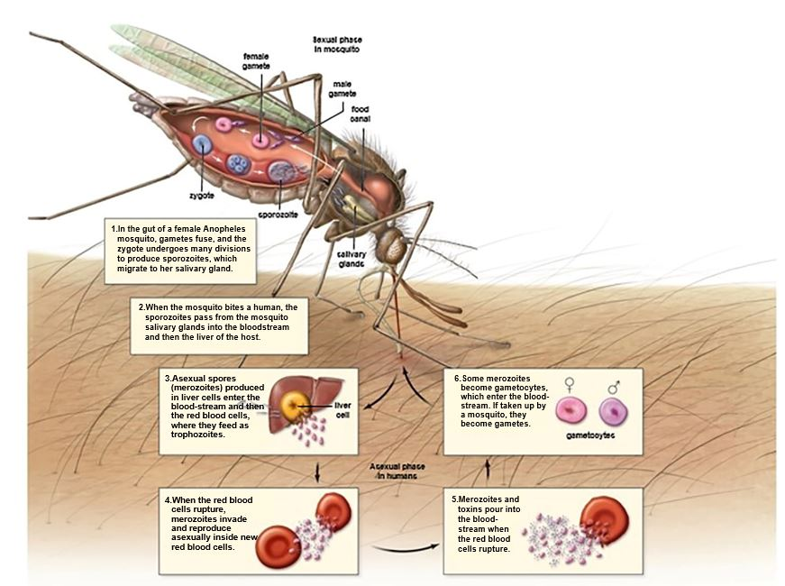
Life Cycle of Plasmodium vivax
Figure 21.8
Access the text alternative for slide images.

Slide 28
Ciliates
Ciliates are among the most complex of the protozoans
  Hundreds of cilia beat in coordinated rhythm
  Most ciliates ingest their food
  They divide by transverse binary fission during asexual reproduction
  Two types of nuclei:
    Micronuclei – participate in reproduction
    Macronucleus – controls normal cell metabolism
  Sexual reproduction involves conjugation and exchange of haploid nuclei
  Ichthyophthirius is an ectoparasitic protozoan that causes the fish disease “ick”

Slide 29
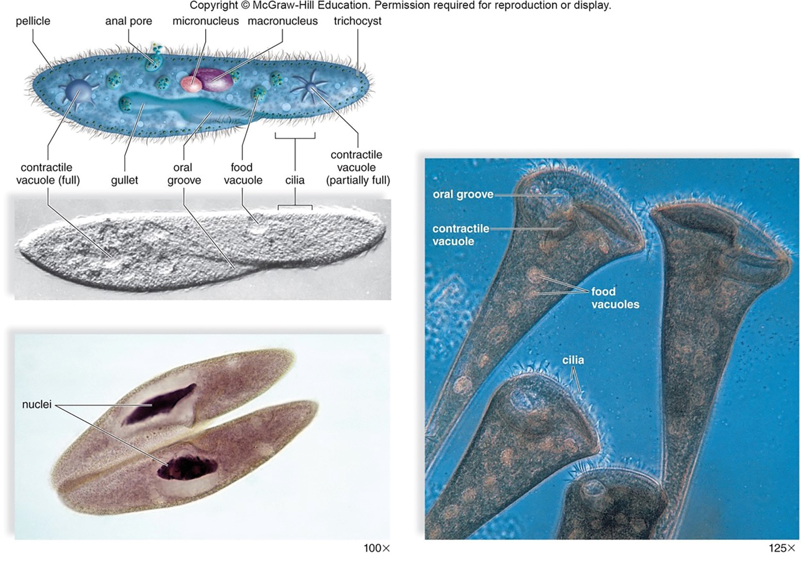
Ciliates Examples
Figure 21.9
Access the text alternative for slide images.
(photos): (a): Carolina Biological Supply/Diomedia; (b): Ed Reschke/Photolibrary/Getty Images; (c): Eric Grave/Science Source

Slide 30
Diatoms
A diatom is a single-celled stramenopile with an ornate silica shell
Make up a significant portion of the plankton
  Reproduce sexually and asexually
  Diatomaceous earth, made of the remains of diatoms, is used as
    A filtering agent
    Soundproofing material
    A polishing abrasive

Slide 31
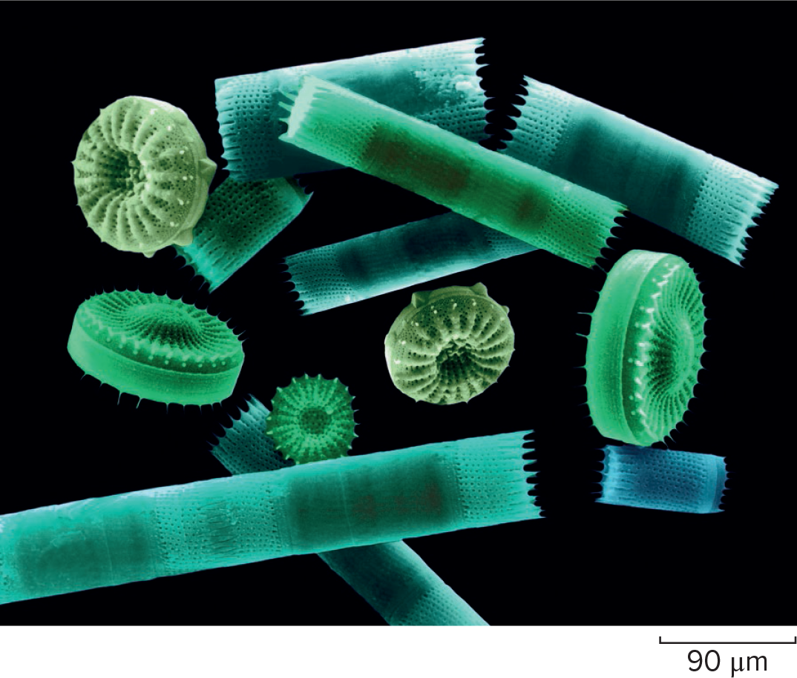
Diatoms Example
Figure 21.10

Slide 32
Golden Brown Algae
  Have yellow-brown carotenoid accessory pigments
  Unicellular or colonial
  Usually have two flagella with tubular hairs
  Many species are mixotrophs
    Capable of photosynthesis and phagocytosis
  Contribute to freshwater and marine phytoplankton

Slide 33
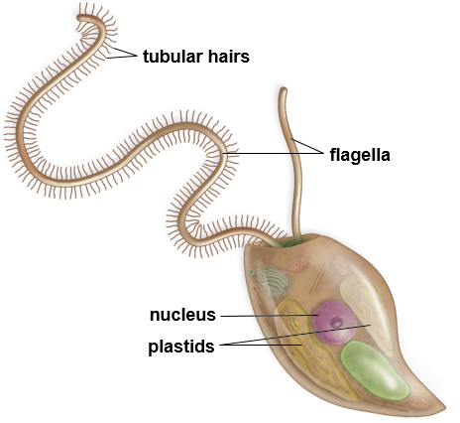
Ochromonas, a Golden Brown Alga
Figure 21.11

Slide 34
Brown Algae
  Most live in colder ocean waters along rocky coasts
  Morphology:
    Some are small forms with simple filaments
    Others are large multicellular forms that may exceed 200 m in length
  Accessory carotenoid pigment provides brown color
  Excess food is stored as a carbohydrate called laminarin
Harvested for food and fertilizer

Slide 35
More Brown Algae
  Laminaria (a kelp) and Fucus (rockweed) are common intertidal seaweeds
Laminaria shows tissue differentiation
    Transports organic nutrients in a tissue resembling phloem in land plants
  Macrocystis is the source of algin, a thickener for foods such as ice cream, sherbet, and cream cheese
  Most brown algae have alternation of generations

Slide 36
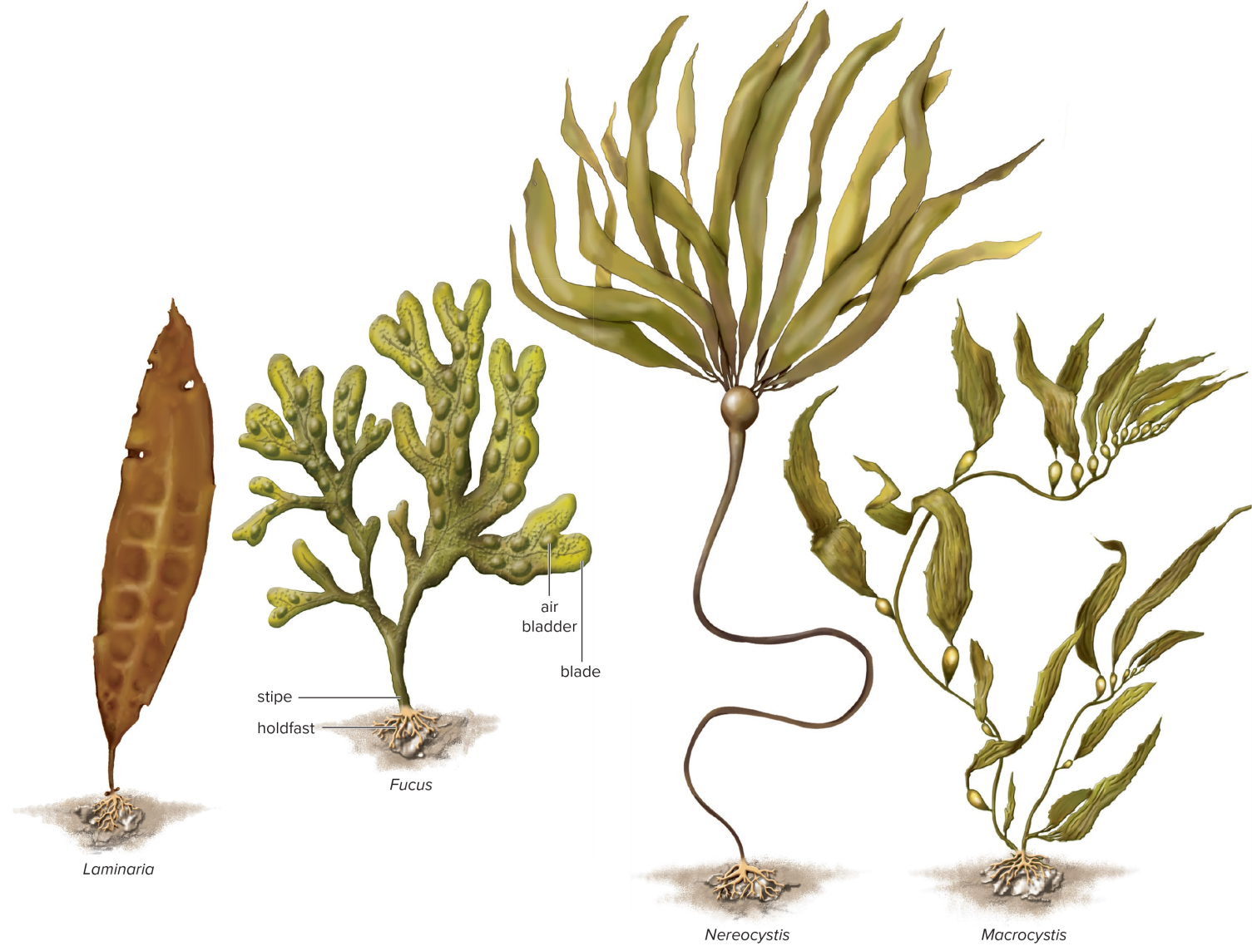
Brown Algae Examples
Figure 21.12

Slide 37
Oomycetes
Fungus-like diploid protists also known as water molds
Most live in the water
Form furry growths on their food source
Some live on land and parasitize insects and plants
  Most are saprotrophic and feed on dead organic matter
  Responsible for the potato famine in Ireland in the 1840s and the mildew of grapes in France in the 1870s
  Cell walls composed largely of cellulose
  Life cycle
    Produce asexual flagellated diploid zoospores
    Meiosis produces sexual haploid gametes

Slide 38
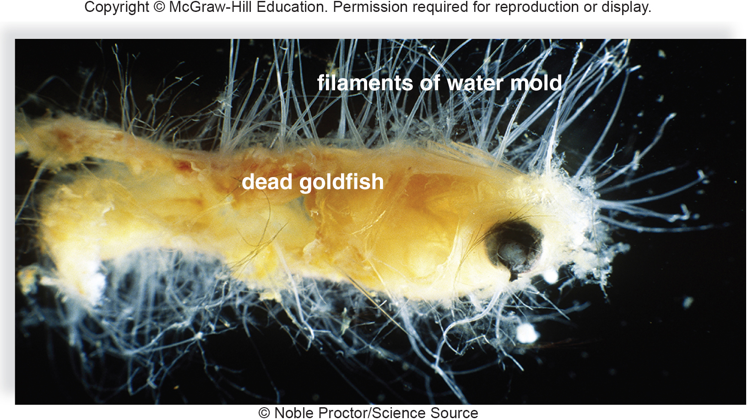
Water Mold
Figure 21.13
Noble Proctor/Science Source

Slide 39
21.4 Supergroup Rhizaria
  Are comprised of cercozoans, foraminiferans, and radiolarians
    Classified together based on rRNA sequence data
    Members of this group do not share very many morphological characteristics
    Commonalities include thin, threadlike pseudopods and many produce a shell that can be fossilized

Slide 40
Cercozoa
  Have pseudopods or flagella
  Many have an outer netlike appearance
  Some species have sausage-shaped endosymbiotic cyanobacteria
  Endosymbiosis event occurred recently
    100 million years ago

Slide 41
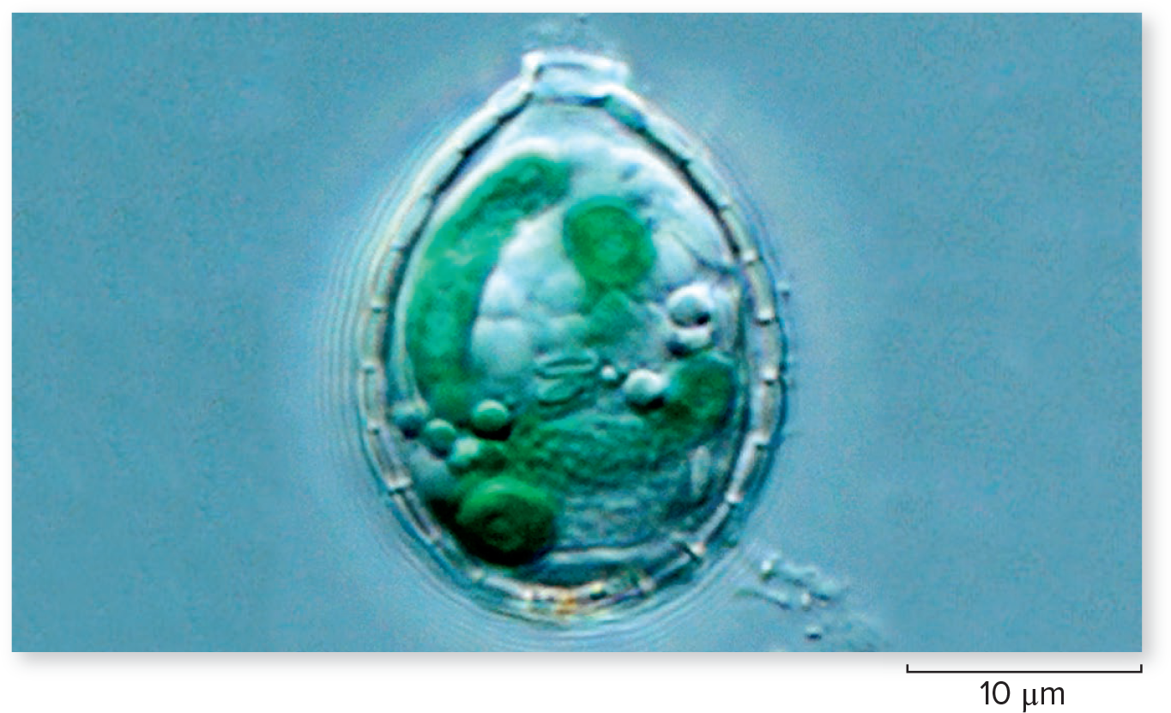
The Cercozoan Pulinella chromatophora
Figure 21.14

Slide 42
Foraminiferans and Radiolarians
Foraminiferans
Organisms with fine, threadlike pseudopods
Skeleton is known as a test
  Foraminiferan test is composed of calcium carbonate and is multichambered
  Pseudopods extend through openings in test
Each geological period has a distinctive form of foraminiferan
  Can be used as index fossils to date sedimentary rock
  Ancient deposits formed the White Cliffs of Dover
Radiolarians
  Test is comprised of silicon and are used as indicators of oil deposits on land and sea
  Fossils date back to the Precambrian

Slide 43
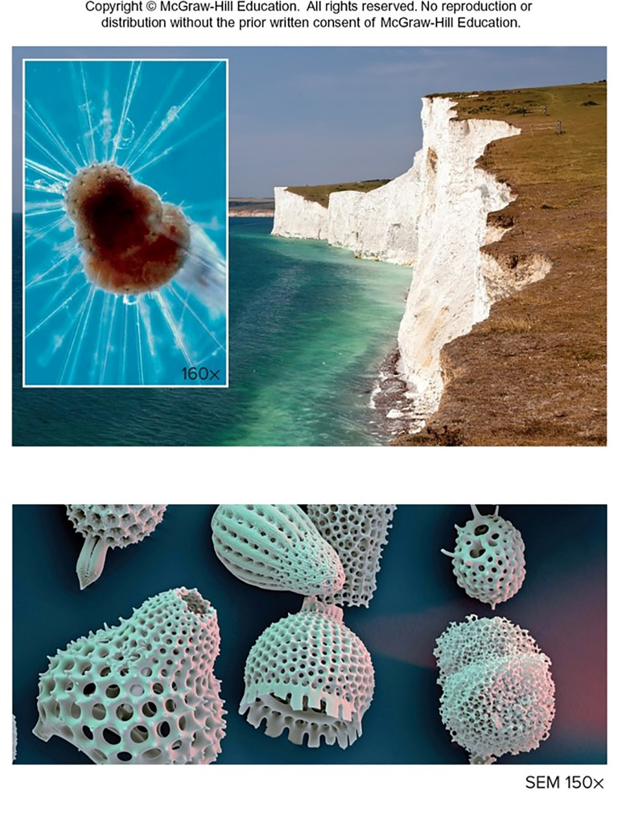
Foraminiferans and Radiolarians Examples
Figure 21.15
Access the text alternative for slide images.
(a): (cliffs): Platsee/Shutterstock; (inset): NHPA/SuperStock; (b): Eye of Science/Science Source

Slide 44
21.5 Supergroup Archaeplastida
Includes land plants and other photosynthetic organisms that have plastids derived from endosymbiotic cyanobacteria
Red Algae
  Multicellular seaweeds
  Possess red and blue accessory pigments, which transfer energy from absorbed light to the photosynthetic pigment chlorophyll during photosynthesis
  Much smaller and more delicate than brown algae
  Live mostly in warmer seawater, some at depths greater than 70 m
  Economic Importance
    Agar – capsules for drugs, dental impressions, cosmetics, bacterial culture medium, electrophoresis, food prep
    Carrageenan – an emulsifying agent used in the production of chocolate and cosmetics
    The reddish-black wrappings around sushi rolls consist of processed Porphyra blades

Slide 45
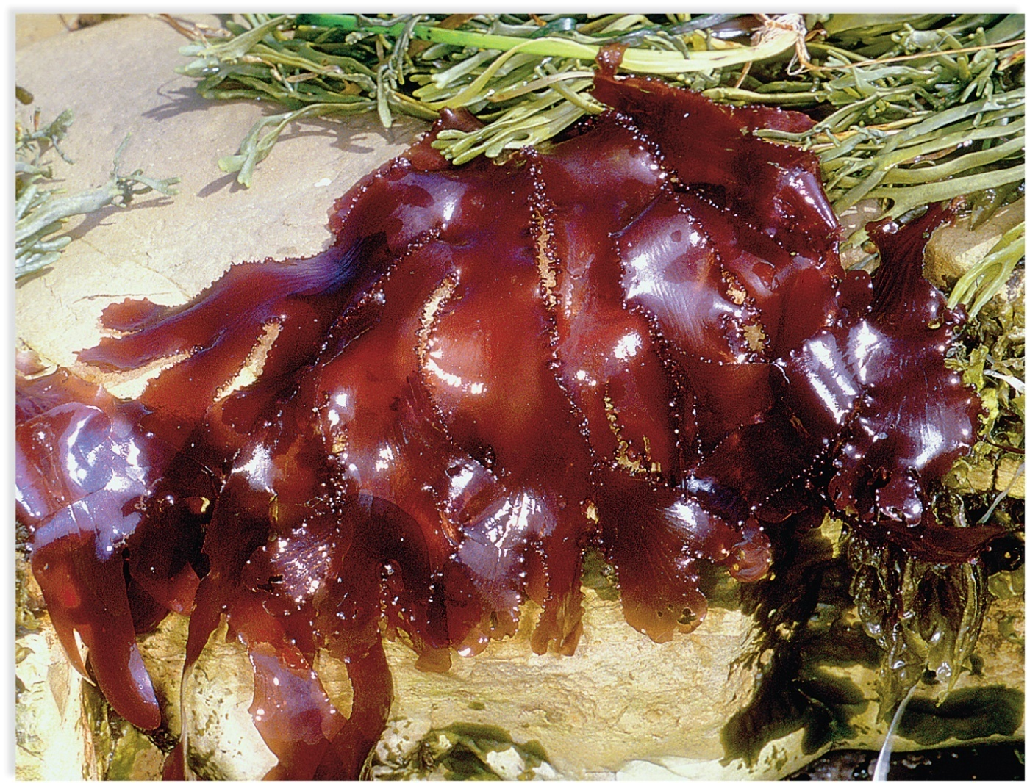
Red Algae
Figure 21.16
Steven P. Lynch

Slide 46
Green Algae
Green algae refers to many phyla of protists that contain both chlorophylls a and b and carry out photosynthesis
  Inhabit a variety of environments including oceans, freshwater, snowbanks, tree bark, and the backs of turtles
  Many are symbionts with fungi, plants, or animals
  Morphology varies
    The majority are unicellular, but some are filamentous or colonial
    Seaweeds are multicellular and resemble leaves of lettuce
    They may be orange-, red-, or rust-colored
  Subdivided into two groups, the chlorophytes and charophytes
    Land plants are thought to be derived from charophytes

Slide 47
Chlorophytes
Chlamydomonas: tiny chlorophyte that inhabits still, freshwater pools
  Fossil ancestors date back over a billion years
  Defined cell wall and a single, large, cup-shaped chloroplast
  Chloroplast contains a pyrenoid where starch is synthesized
  Many species have a bright red, light sensitive eyespot
    Guides organism toward light for photosynthesis
    In favorable conditions, Chlamydomonas exists as haploid cells
      Known as vegetative cells which reproduce asexually by mitosis
    In unfavorable conditions, Chlamydomonas reproduces sexually
      Produce zygospores which lay dormant until conditions are favorable
      Zygospores undergo meiosis producing zoospores which grow to become vegetative cells

Slide 48
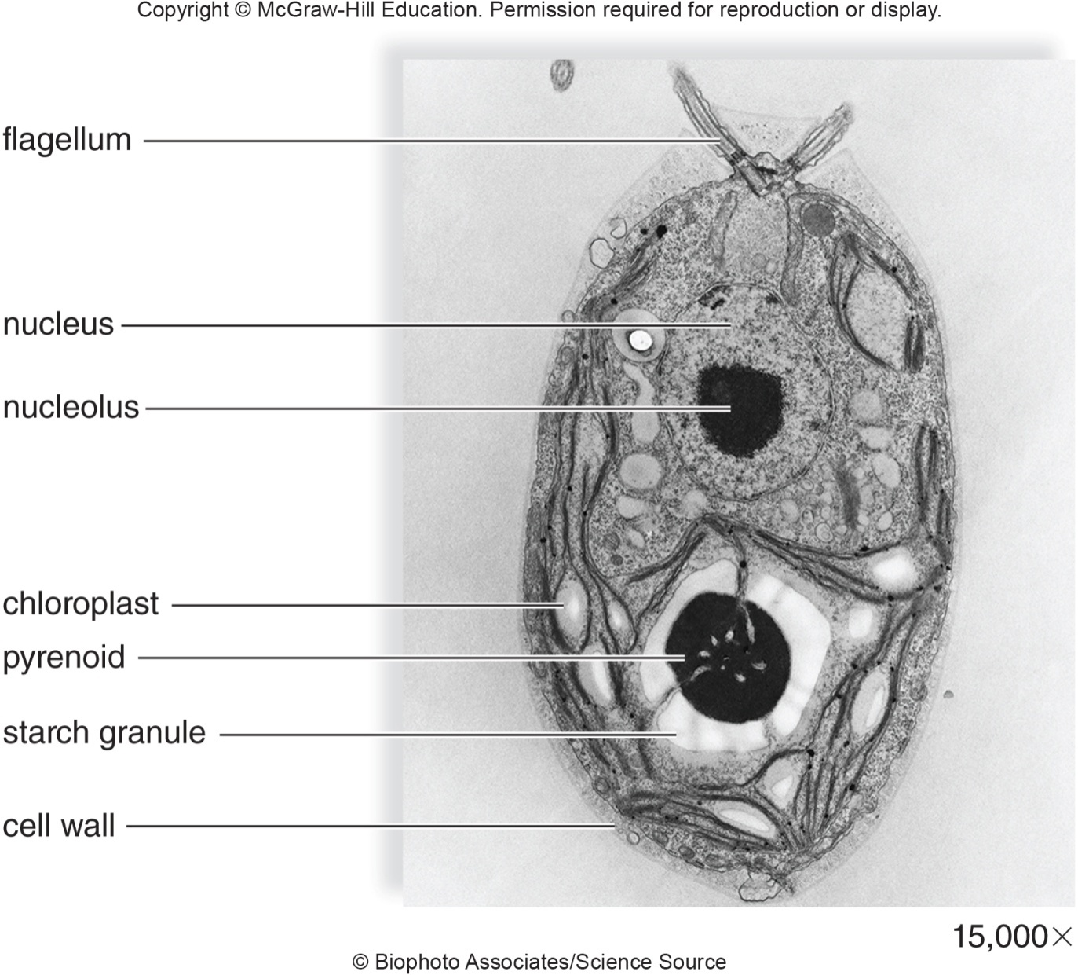
Electron Micrograph of Chlamydomonas
Figure 21.17
Biophoto Associates/Science Source

Slide 49
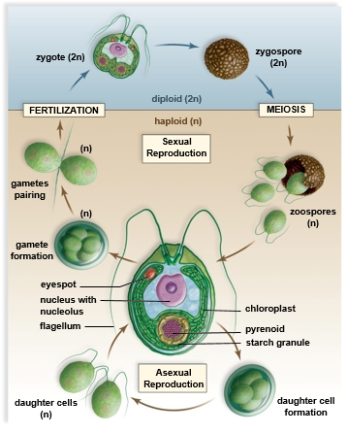
Haploid Life Cycle of Chlamydomonas
Figure 21.18
Access the text alternative for slide images.

Slide 50
Volvox
Colonial green alga
  A colony is a loose association of independent cells
A Volvox colony is a hollow sphere
  Thousands of cells arranged in a single layer surrounding a watery interior
  Colony moves because flagella beat in a coordinated fashion
  Some cells are specialized for reproduction
      Each can divide asexually to form a new daughter colony within the parental colony
      The daughter colony leaves the parental colony by releasing an enzyme that dissolves away a portion of the parental colony

Slide 51
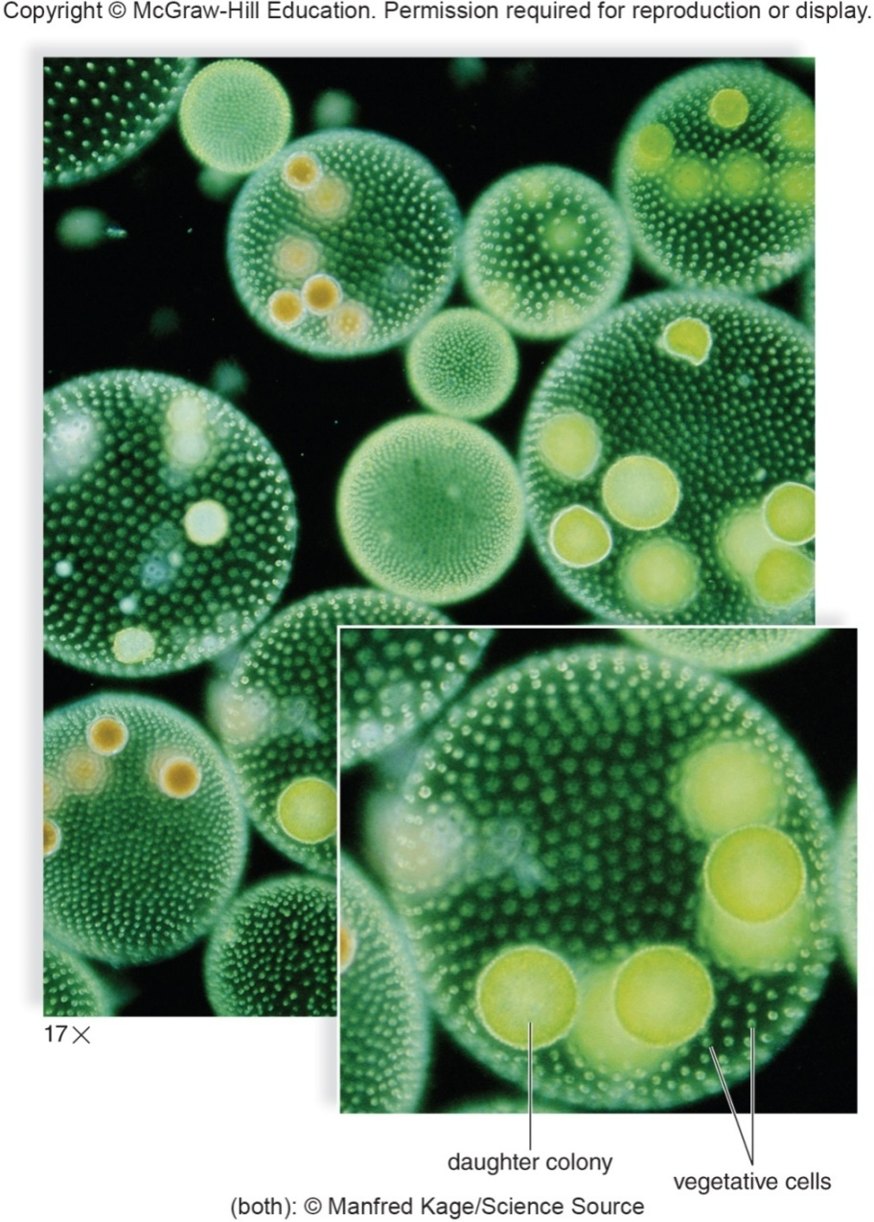
Volvox Example
Figure 21.19
(main): Manfred Kage/Science Source; (inset): Manfred Kage/Science Source

Slide 52
Ulva
Multicellular green alga
Commonly called sea lettuce
Body is two cells thick and can be as much as a meter long.
Sexual cycle involves alternation of generations
  Similar to land plants

Slide 53
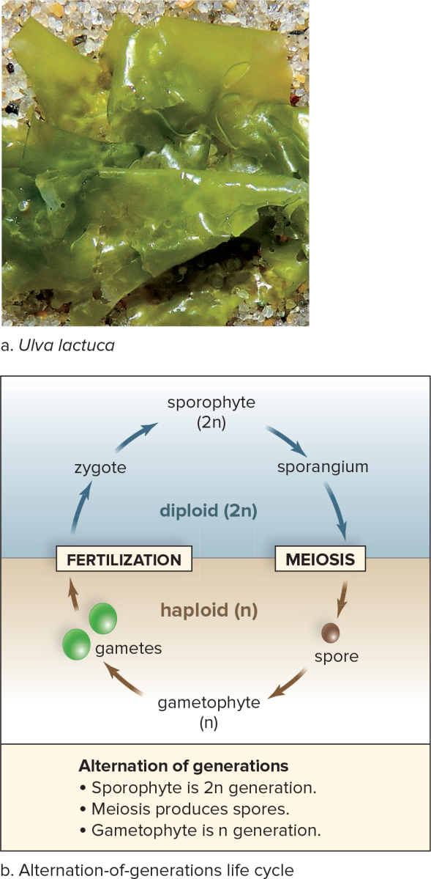
Ulva Example
Figure 21.20
Access the text alternative for slide images.
(a): ©Evelyn Jo Johnson

Slide 54
Charophytes
Charophytes are filamentous green algae
  Filaments – end-to-end chains of cells
Spirogyra is an unbranched charophyte
  Found in green masses on the surfaces of ponds and streams
  Has ribbonlike, spiraled chloroplasts
  Sexual reproduction by conjugation
    A temporary union during which the cells exchange genetic material
    Two haploid filaments line up parallel to each other
    Cell contents of one filament move into the cells of the other filament forming diploid zygospores
    Zygospores eventually undergo meiosis to produce new haploid filaments

Slide 55
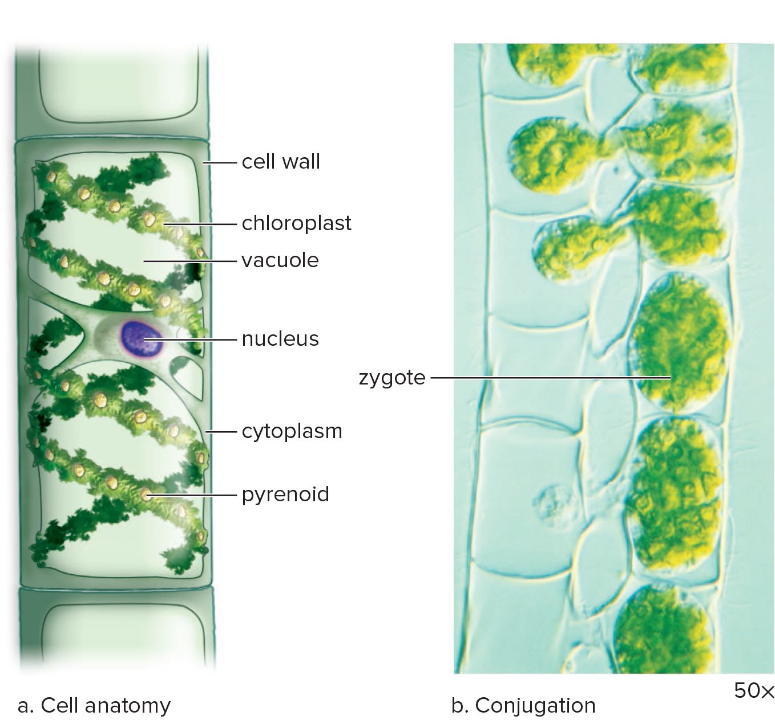
Spirogyra
Figure 21.21
Access the text alternative for slide images.
(b): M.I. Walker/Science Source

Slide 56
Chara
Chara is a charophyte found in freshwater lakes and ponds
  Commonly called a stonewort
  Encrusted with calcium carbonate deposits
  Main strand of alga can be over a meter long
  Cells anchored by rhizoids
  Whorls of branches occur at multicellular nodes
  DNA sequencing data suggest the stoneworts are most closely related to land plants

Slide 57
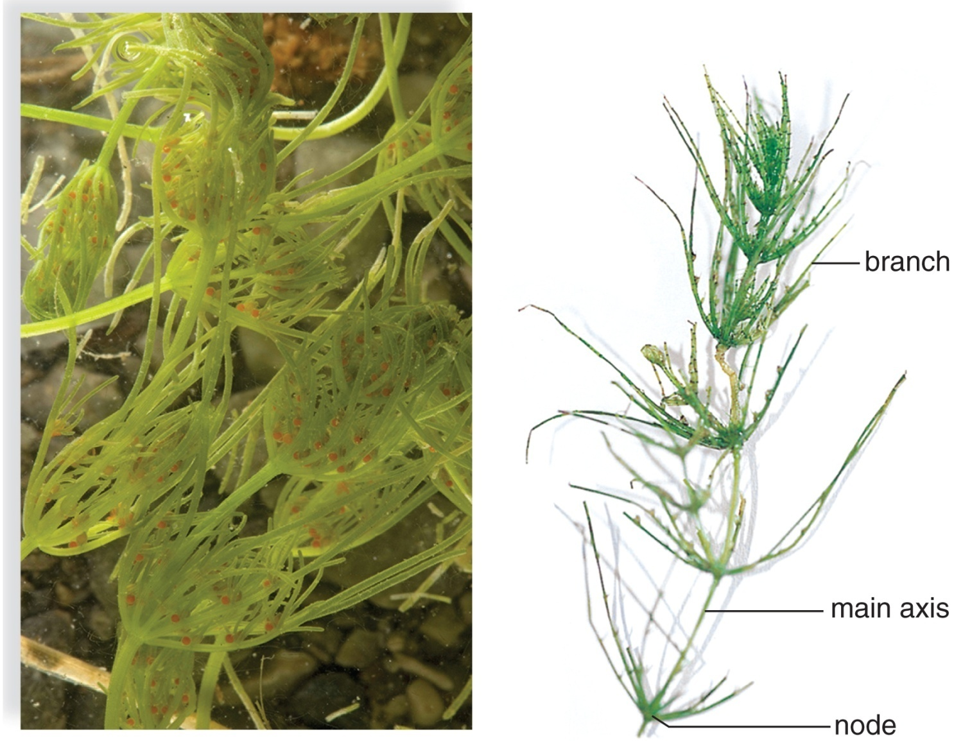
Chara Examples
Chara, several individuals
One individual
Figure 21.22
(a): Bob Gibbons/Alamy Stock Photo; (b): © Kingsley Stern

Slide 58
21.6 Supergroup Amoebozoa
Amoebozoans are protozoans that move by pseudopods
  Pseudopods form when cytoplasm streams forward in a particular direction
  Amoeboids are protists that move and ingest their food with pseudopods
    Feed by phagocytosis
    Amoeba proteus is commonly studied in biology labs
    Entamoeba histolytica is a parasite of the human colon
      Causes amoebic dysentery
    Naegleria fowleri is known as the “brain eating amoeba”
      Can cause a fatal brain infection
      Lives in warm freshwater and can be acquired by inhaling water when swimming

Slide 59
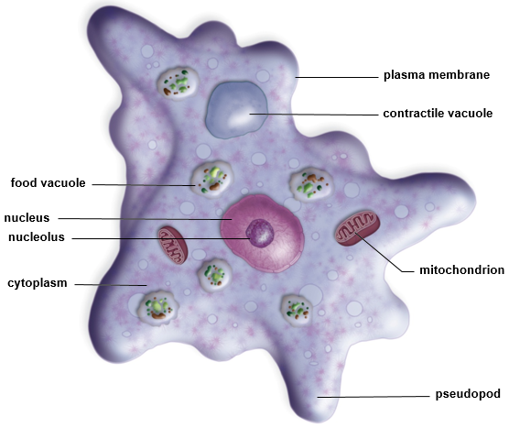
Amoeba proteus
Figure 21.23

Slide 60
Slime Molds
  Important decomposers
    Feed on dead plant material
    Once classified as fungi but lack cell walls and have flagellated cells at some point in life cycle
  Vegetative state is mobile and amoeboid
  Produce spores by meiosis
    Spores germinate to form gametes
  Two forms of slime molds
    Plasmodial slime molds
    Cellular slime molds

Slide 61
Plasmodial Slime Molds
  Body in the form of a plasmodium
    Diploid, multinucleated, sluglike cytoplasmic mass
    Surrounded by a slimy sheath
  Consumes decaying plant material as it creeps along ground
  In unfavorable conditions, produces many sporangia, reproductive structures which produce spores
  Aggregate of sporangia is called a fruiting body
  Spores can remain dormant until environmental conditions are suitable
    Spores germinate to form either a haploid flagellated cell or an amoeboid cell
    Two haploid cells fuse to form a zygote that grows into a multinucleated plasmodium

Slide 62
Cellular Slime Molds
  Exist as individual amoeboid cells
  Common in soil and feed on bacteria and yeasts
  Cells release a chemical when environmental conditions are unfavorable
    Cells then aggregate and form a pseudoplasmodium
      Forms sporangia and spores
      When environmental conditions improve spores germinate releasing amoeboid cells

Slide 63
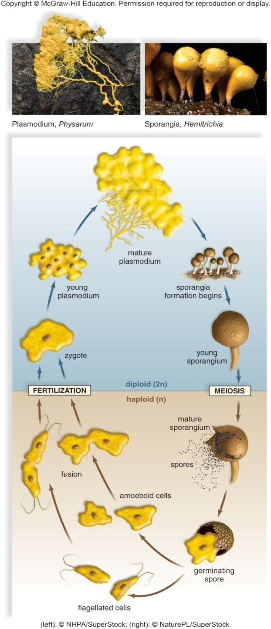
Life Cycle of a Slime Mold
Figure 21.24
Access the text alternative for slide images.
(photos): (left): NHPA/SuperStock; (right): NaturePL/SuperStock

Slide 64
21.7 Supergroup Opisthokonta
  This supergroup includes animals, fungi, and several closely related protists
    Choanoflagellates
      Some single-celled and some colonial
      Filter feeders with cells that resemble the choanocytes found inside sponges
      Filter feeders
        Each cell has a posterior flagella surrounded by a collar
        As flagella moves, water is drawn through cell and food captured by phagocytosis

Slide 65
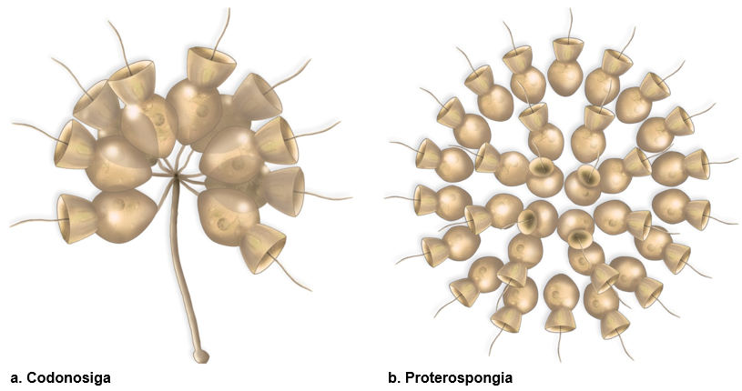
Colonial Choanoflagellates
Codonosiga
Proterospongia
Figure 21.25
Access the text alternative for slide images.

Slide 66
End of main content
Copyright 2022 © McGraw Hill LLC. All rights reserved. No reproduction or distribution without the prior written consent of McGraw Hill LLC.

Slide 67
Accessibility Content: Text Alternatives for Images

Slide 68
Proposed Evolutionary Relationships Among the Eukaryotic Supergroups - Text Alternative
Return to parent-slide containing images.
Common eukaryotic ancestor branches into excavata species as: diplomonads, parabasalids and euglenozoans.
Common eukaryotic ancestor branches into chromalveolata species as: dinoflagellates, apicomplexans and ciliates (through alveolates) and diatoms, golden algae, brown algae and Oomycetes (through stramenopiles).
Common eukaryotic ancestor branches into rhizaria species as: cercozoans, forams and Radiolarians.
Common eukaryotic ancestor branches into archaeplastida species as: red algae, chlorophytes (green algae) and land plants.
Common eukaryotic ancestor branches into amoebozo species as: amoebozoa.
Common eukaryotic ancestor branches into opisthokonta species as: fungi, choanoflagellates and animals.
Return to parent-slide containing images.

Slide 69
Euglena - Text Alternative
Return to parent-slide containing images.
Diagram of leaf shaped Euglena shows a longitudinal short and long flagellum, ovular contractile vacuole, ovular eyespot, photoreceptor, carbohydrate granule, circular nucleus, nucleolus, pyrenoid and ovular chloroplast and pellicle band across circumference.
Micrograph shows multiple leaf-shaped Euglena with textured bodies, purple nucleus and red nucleolus within it.
Return to parent-slide containing images.

Slide 70
Life Cycle of Plasmodium vivax - Text Alternative
Return to parent-slide containing images.
1. In the gut of a female Anopheles mosquito, gametes fuse, and the zygote undergoes many divisions to produce sporozoites, which migrate to her salivary gland. 2. When the mosquito bites a human, the sporozoites pass from the mosquito salivary glands into the bloodstream and then the liver of the host. 3. Asexual spores (merozoites) produced in liver cells enter the blood-stream and then the red blood cells, where they feed as trophozoites. 4. When the red blood cells rupture, merozoites invade and reproduce asexually inside new red blood cells. 5. Merozoites and toxins pour into the bloodstream when the red blood cells rupture. 6. Some merozoites become gametocytes, which enter the bloodstream. If taken up by a mosquito, they become gametes.
Return to parent-slide containing images.

Slide 71
Ciliates Examples - Text Alternative
Return to parent-slide containing images.
A) Diagram of ovoid Paramecium shows a pellicle across the circumference, circular anal pore, ovular micronucleus and macronucleus, spots of trichocyst, contractile vacuole (partially full), circular food vacuole, irregular shaped oral groove and gullet, circular contractile vacuole (full) with projections of cilia.
Micrograph of Paramecium shows circular depressions of contractile vacuole (full) and food vacuole with structures of oral groove and cilia.
B) Micrograph (enlarged 100 times) shows during conjugation two paramecia first unite at oral areas with two elongated nuclei.
C) Micrograph (enlarged 125 times) shows cylindrical bodies of Stentor with broad upper bases with circular oral groove, contractile and food vacuoles with external projections of cilia.
Return to parent-slide containing images.

Slide 72
Foraminiferans and Radiolarians Examples - Text Alternative
Return to parent-slide containing images.
Microscopic view of Foraminiferans and white deposits on edge of cliff (top). Microscopic view shows spherical body with pores on the surface and spiny white skeleton of silica.
Return to parent-slide containing images.

Slide 73
Haploid Life Cycle of Chlamydomonas - Text Alternative
Return to parent-slide containing images.
Diagram of circular Chlamydomonas shows circular eyespot, nucleus with nucleolus, layers of chloroplast, circular pyrenoid and starch granule with long projections of flagellum.
Haploid (n):
Asexual Reproduction:
Daughter cells (n) lead into the Chlamydomonas body which leads to daughter cell formation.
Diploid (2n):
Sexual Reproduction:
Meiosis results in the formation of zoospores (n) leading to adult vegetative cell (n) which is lead into the body of Chlamydomonas leading to gamete formation (n), gametes pairing (n) which after fertilization results in the formation of zygote (2n) further resulting in zygospore (2n).
Return to parent-slide containing images.

Slide 74
Ulva Example - Text Alternative
Return to parent-slide containing images.
A) Micrograph a green Ulva lactuca with folded body structure.
B) Alternation of generations life cycle:
Sporophyte (2n) leads to sporangium which undergoes meiosis, resulting in the formation of spore, gametophyte (n) and further results into gametes which undergo fertilization to form a zygote.
Zygote, sporophyte and sporangium are diploid (2n) while spore, gametophyte and gametes are haploid (n).
Return to parent-slide containing images.

Slide 75
Spirogyra - Text Alternative
Return to parent-slide containing images.
A) A rectangular cell shows cell wall, coiled chloroplast structures with voids of vacuole, circular nucleus, cytoplasm and circular pyrenoid with layers of chloroplasts.
B) Micrograph of conjugation shows a chain of ovular zygotes with textured surfaces.
Return to parent-slide containing images.

Slide 76
Life Cycle of a Slime Mold - Text Alternative
Return to parent-slide containing images.
The cycle from fertilization to meiosis:
Diploid (2n):
Zygote leads to young plasmodium, leading to mature plasmodium which leads to beginning of sporangia formation, finally leading to young sporangium.
The cycle from meiosis to fertilization:
Haploid (n):
Mature sporangium leads to spore formation which leads to germinating spore, leading to amoeboid cells which finally leads to fusion. Germinating spore also lead to flagellated cells further resulting in fertilization.
Return to parent-slide containing images.

Slide 77
Colonial Choanoflagellates - Text Alternative
Return to parent-slide containing images.
A) Codonosiga colony is depicted as funnel shaped colonies anchored on a slender stalk. B) Proterospongia colony is shown as number of cells embedded in jelly-like matrix.
Return to parent-slide containing images.

